Slide 1




CANADIAN
HOUSING
VISUAL ANALYSIS
By Clinton Boyda

Slide 2
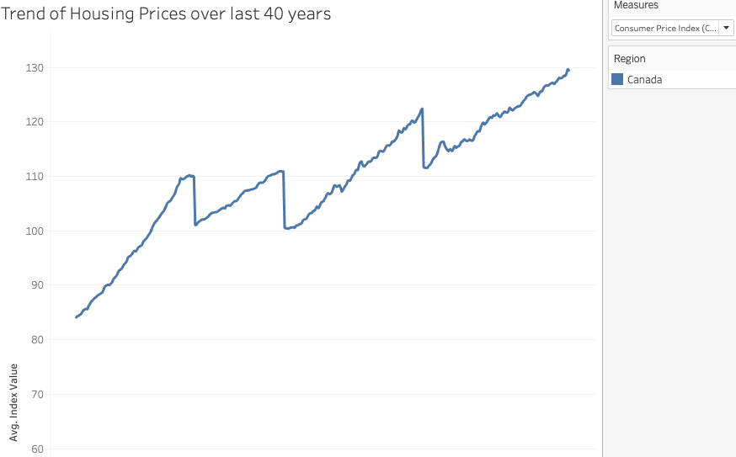


HOUSING PRICES
Trend

Slide 3
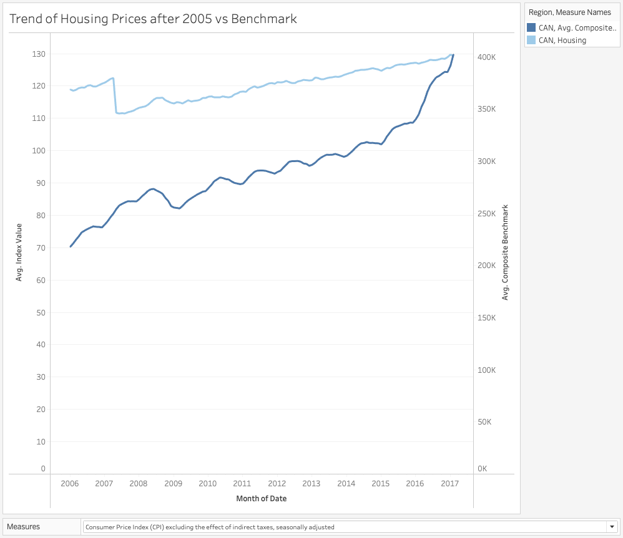

HOUSING PRICES VS BENCHMARK
AVG. INDEX

Slide 4

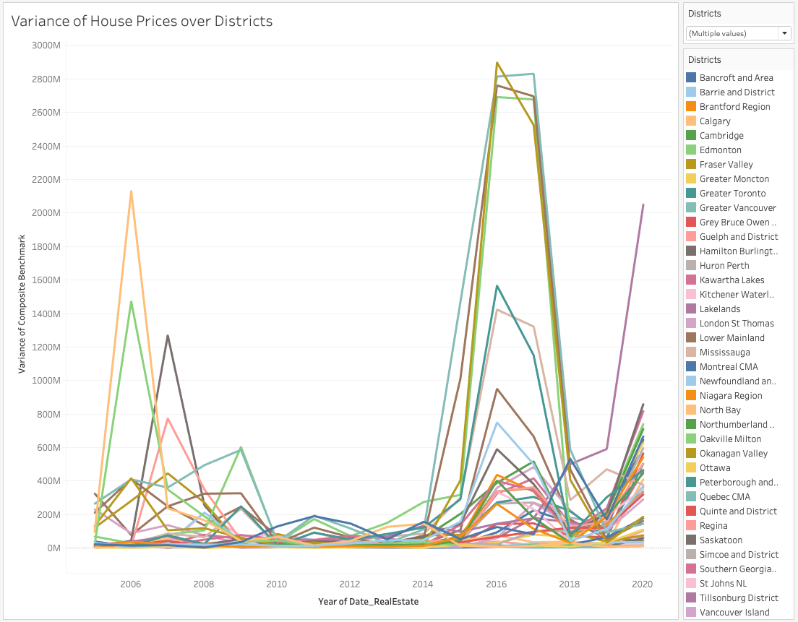
HOUSING PRICE VARIANCE

Slide 5
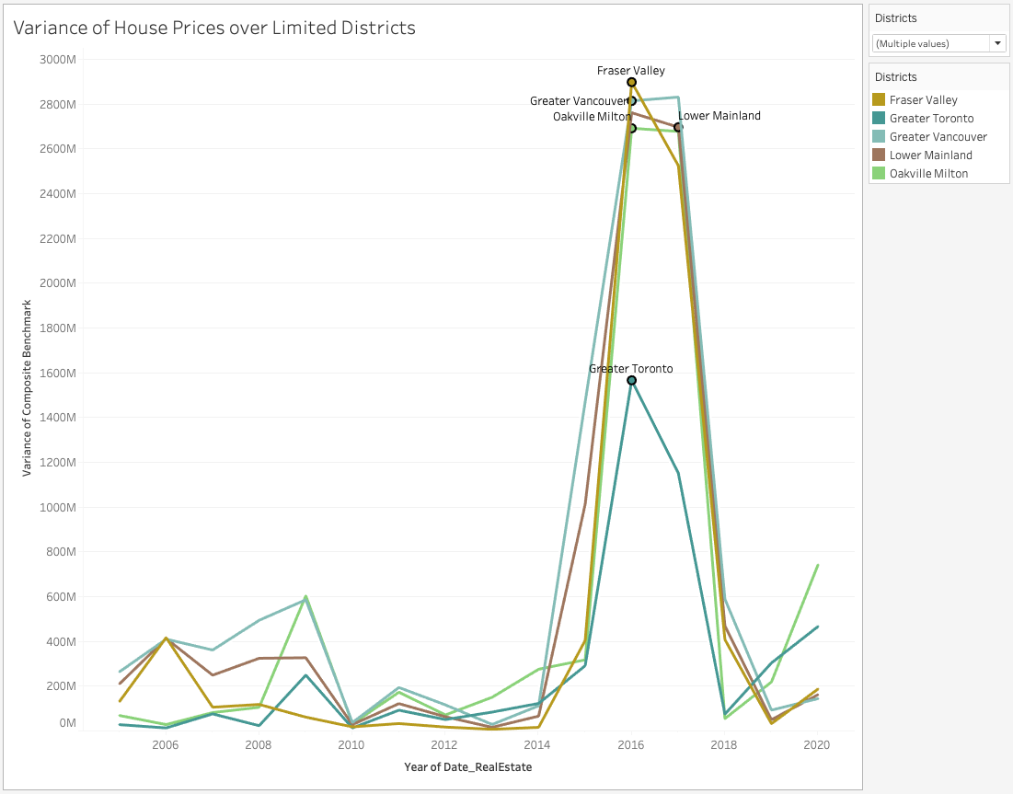
HOUSING PRICE VARIANCE TOP DISTRICTS

Slide 6
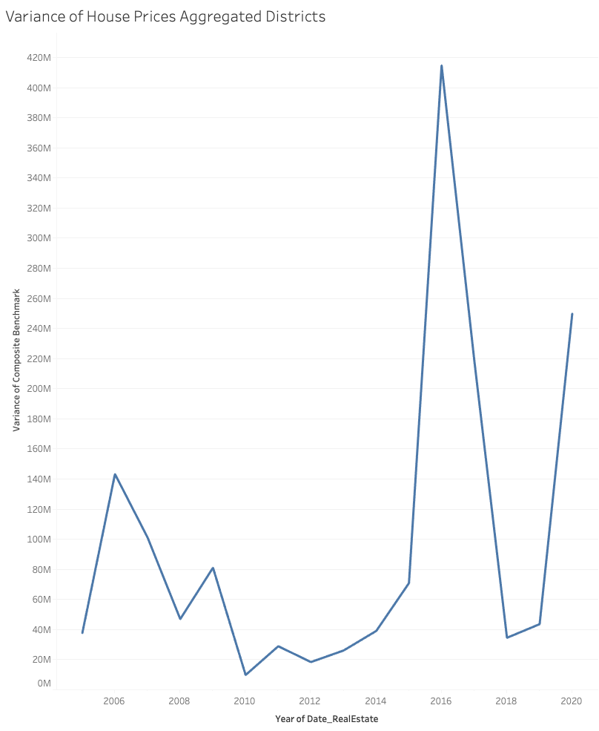
HOUSING PRICE AGGREGATE VARIANCE

Slide 7

WHY DID HOUSING PRICES JUMP IN 2016?
01
ECONOMIC FACTORS
Influenced by strong economic growth,
low interest rates, and favourable employment.
02
SPECULATION & INVESTMENT
Potentially influenced by speculation and investors interested in the housing sector.
03
GOVERNMENT POLICIES
Mortgage regulations, buyer taxes and first-time homebuyer can all impact housing prices.

Slide 8


HOW DOES OUR ECONOMY
AFFECT CONSTRUCTION?

Slide 9
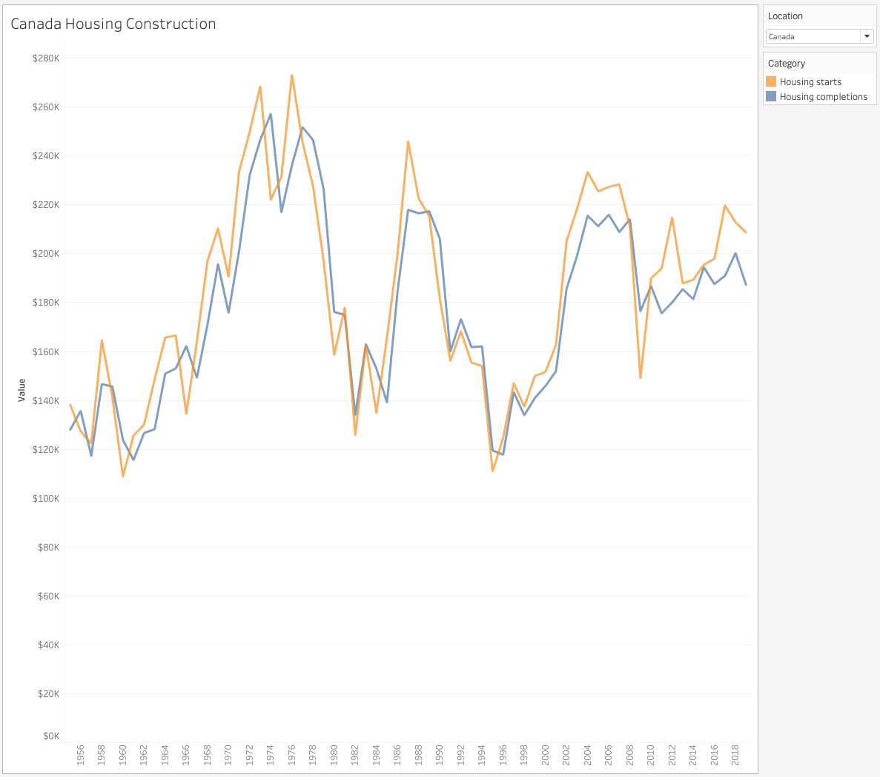
CONSTRUCTION STARTS/DONE

Slide 10
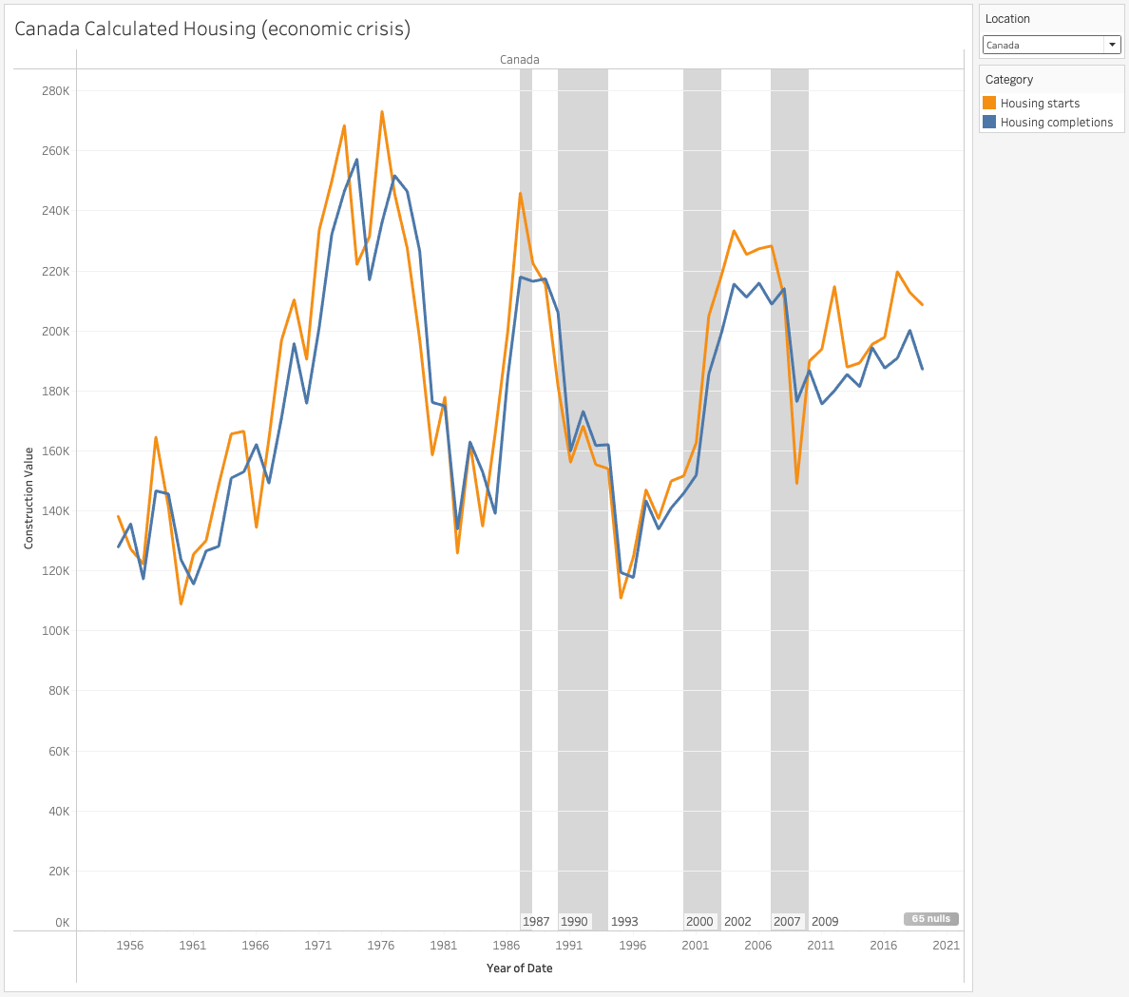
CONSTRUCTION VS ECONOMY
VS PROVINCES

Slide 11
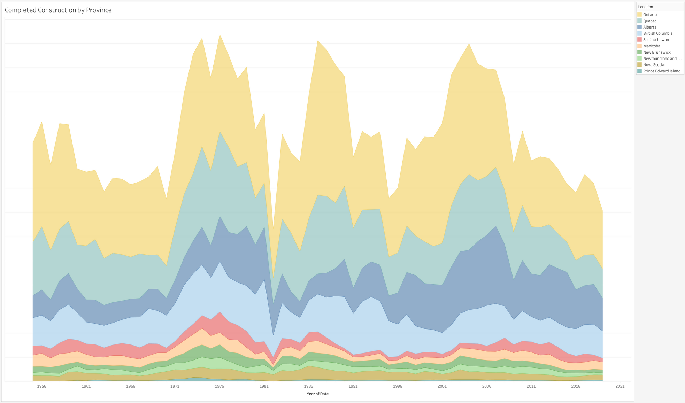
COMPLETED CONSTRUCTION

Slide 12
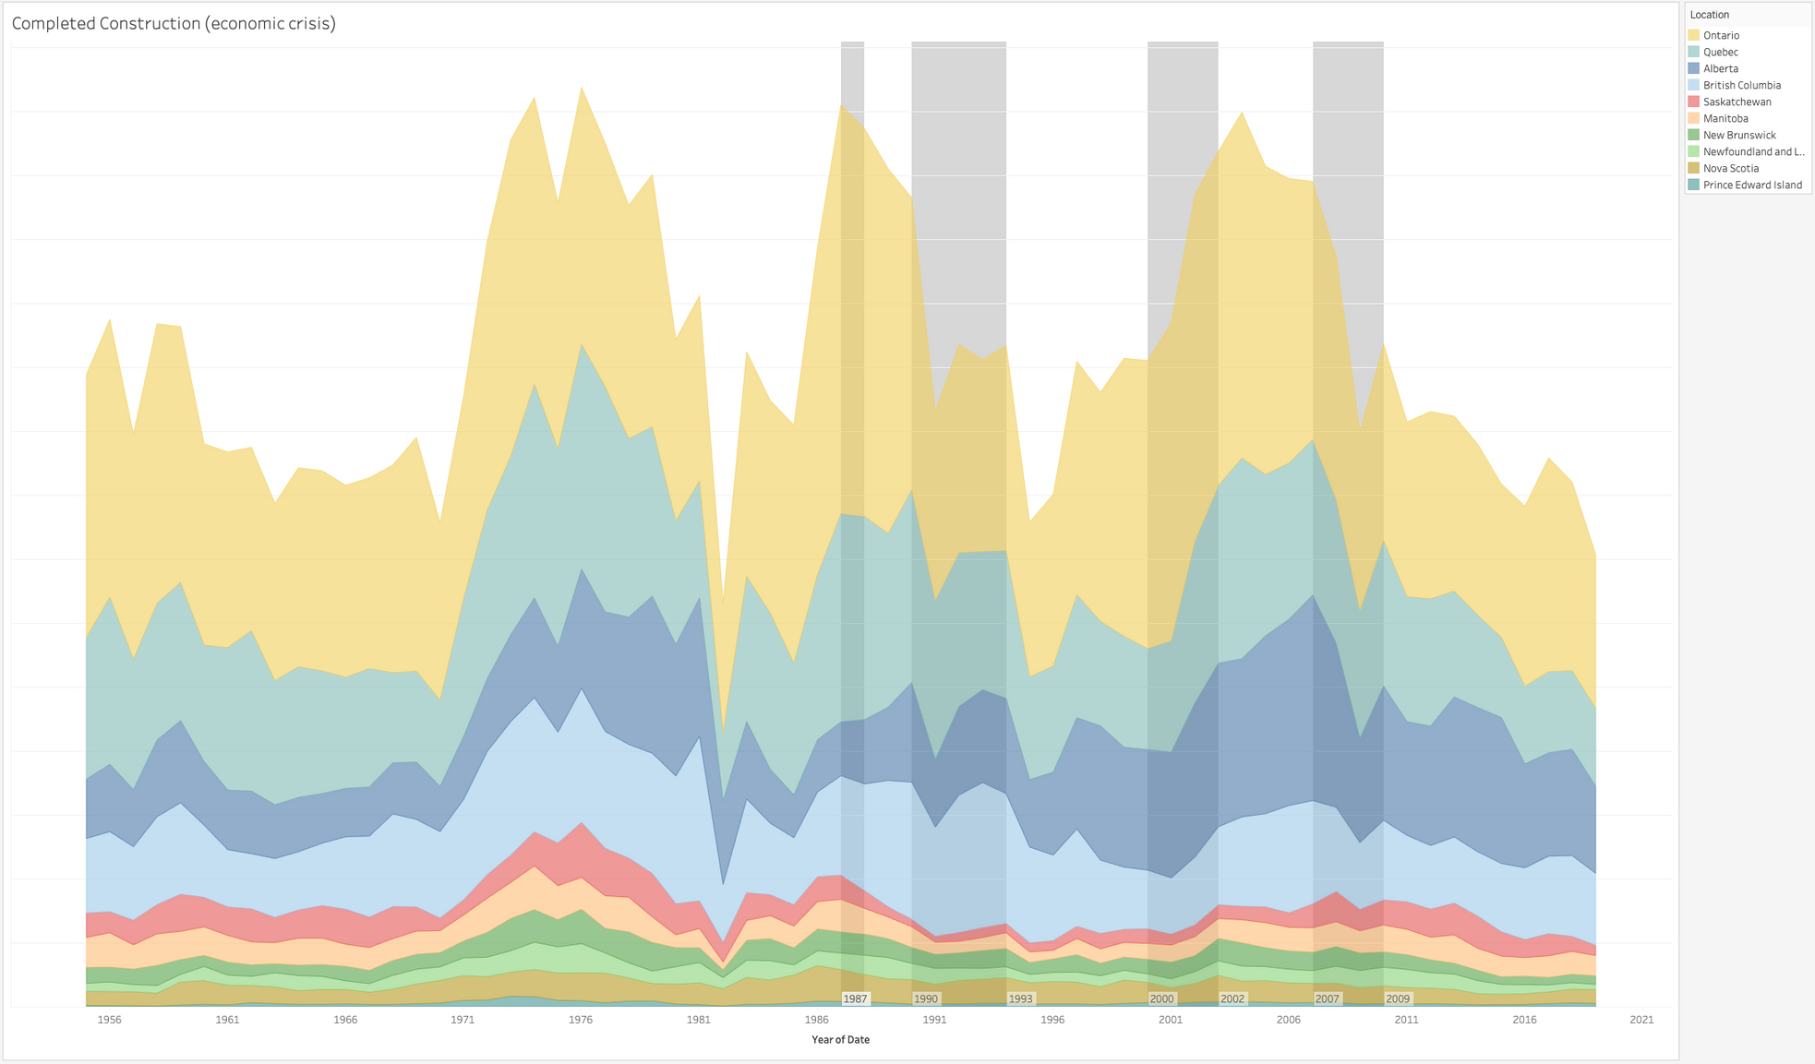
CONSTRUCTION VS ECONOMIC CRISIS

Slide 13

CONSTRUCTION VS ECONOMIC CRISIS
GLOBAL FINANCIAL CRISIS 2007-2009
Originated in the USA with the collapse of the subprime mortgage market.

Slide 14
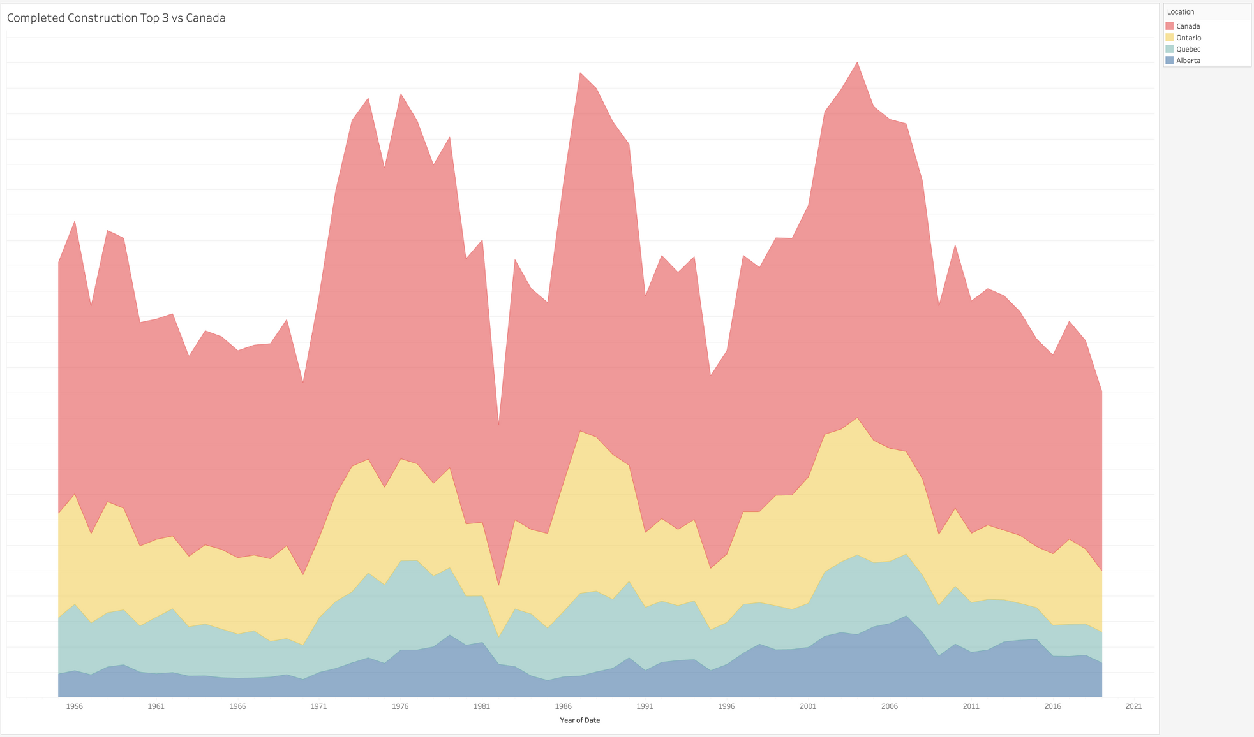
CONSTRUCTION TOP 3 PROVINCES
PER CAPTIA?
VS EARNINGS?

Slide 15
Thank
you!

Slide 16
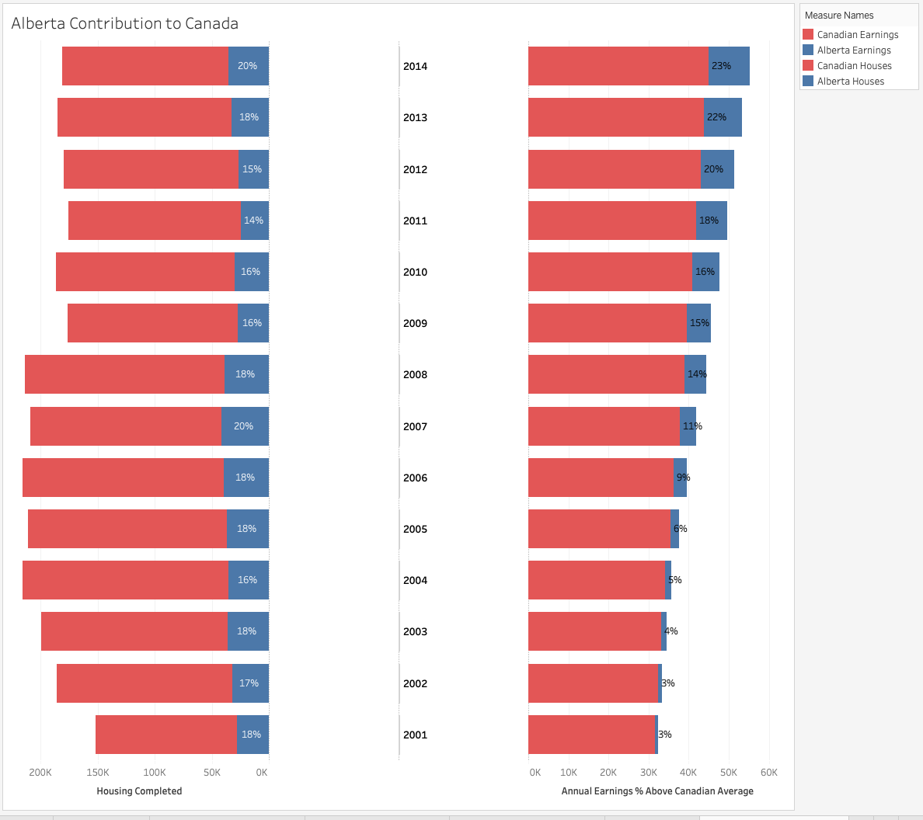
ALBERTA IN CANADA

